Slide 1
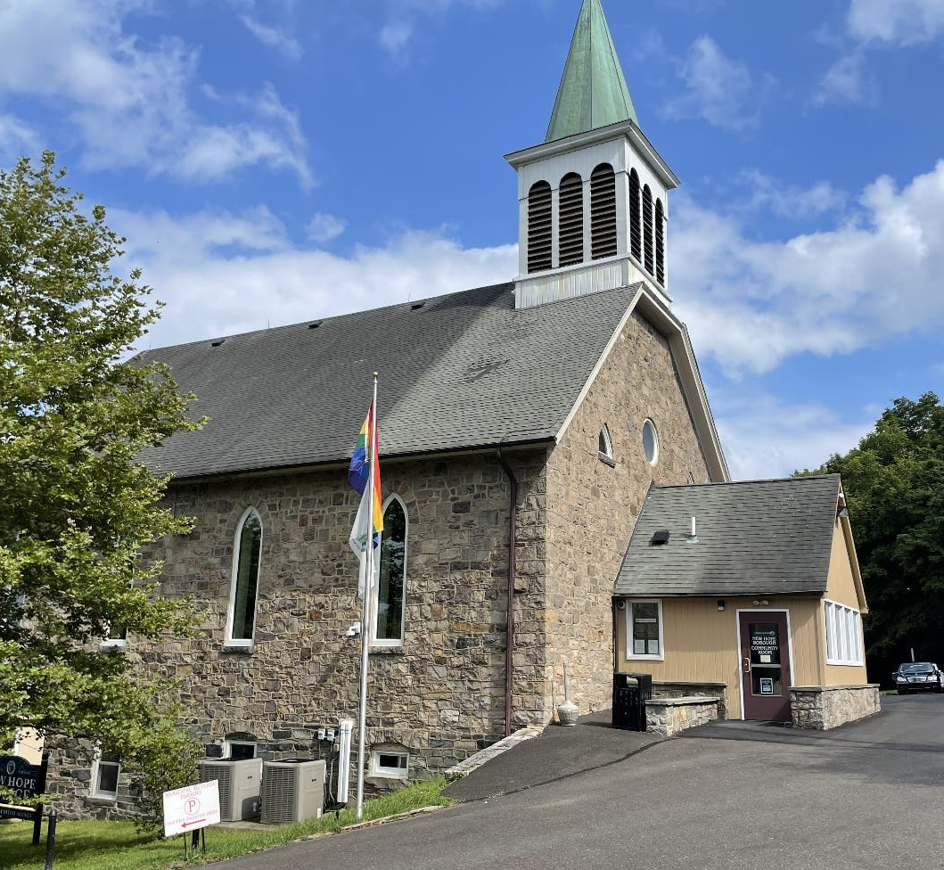


New Hope Borough
Comprehensive Plan Update
Borough Council Meeting
September 2, 2025

Slide 2

Mission Statements/Questions
Guiding Mission Statements/Questions
Where are we as a community?
What do residents love about New Hope Borough? What are residents concerned about most? How to make our town better?
What is our vision of the future? How can we get there?
What can we do to meet these challenges and carry out our vision of the future?

Slide 3
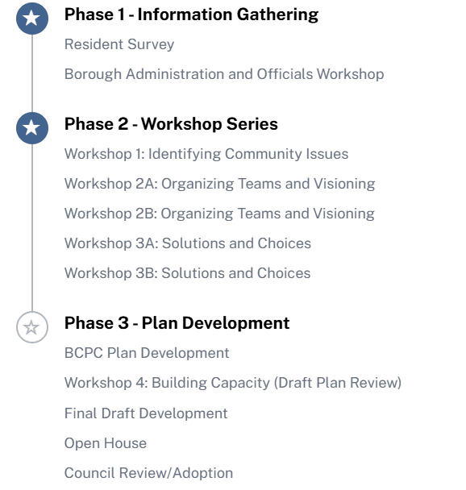
Plan Process & Timeline
12/2024 – 3/2025
6/10/24
2/20/25
5/22/25
6/9/25
3A: Sept 29 | 3B: Oct 20
Late 2025 into 2026

Slide 4
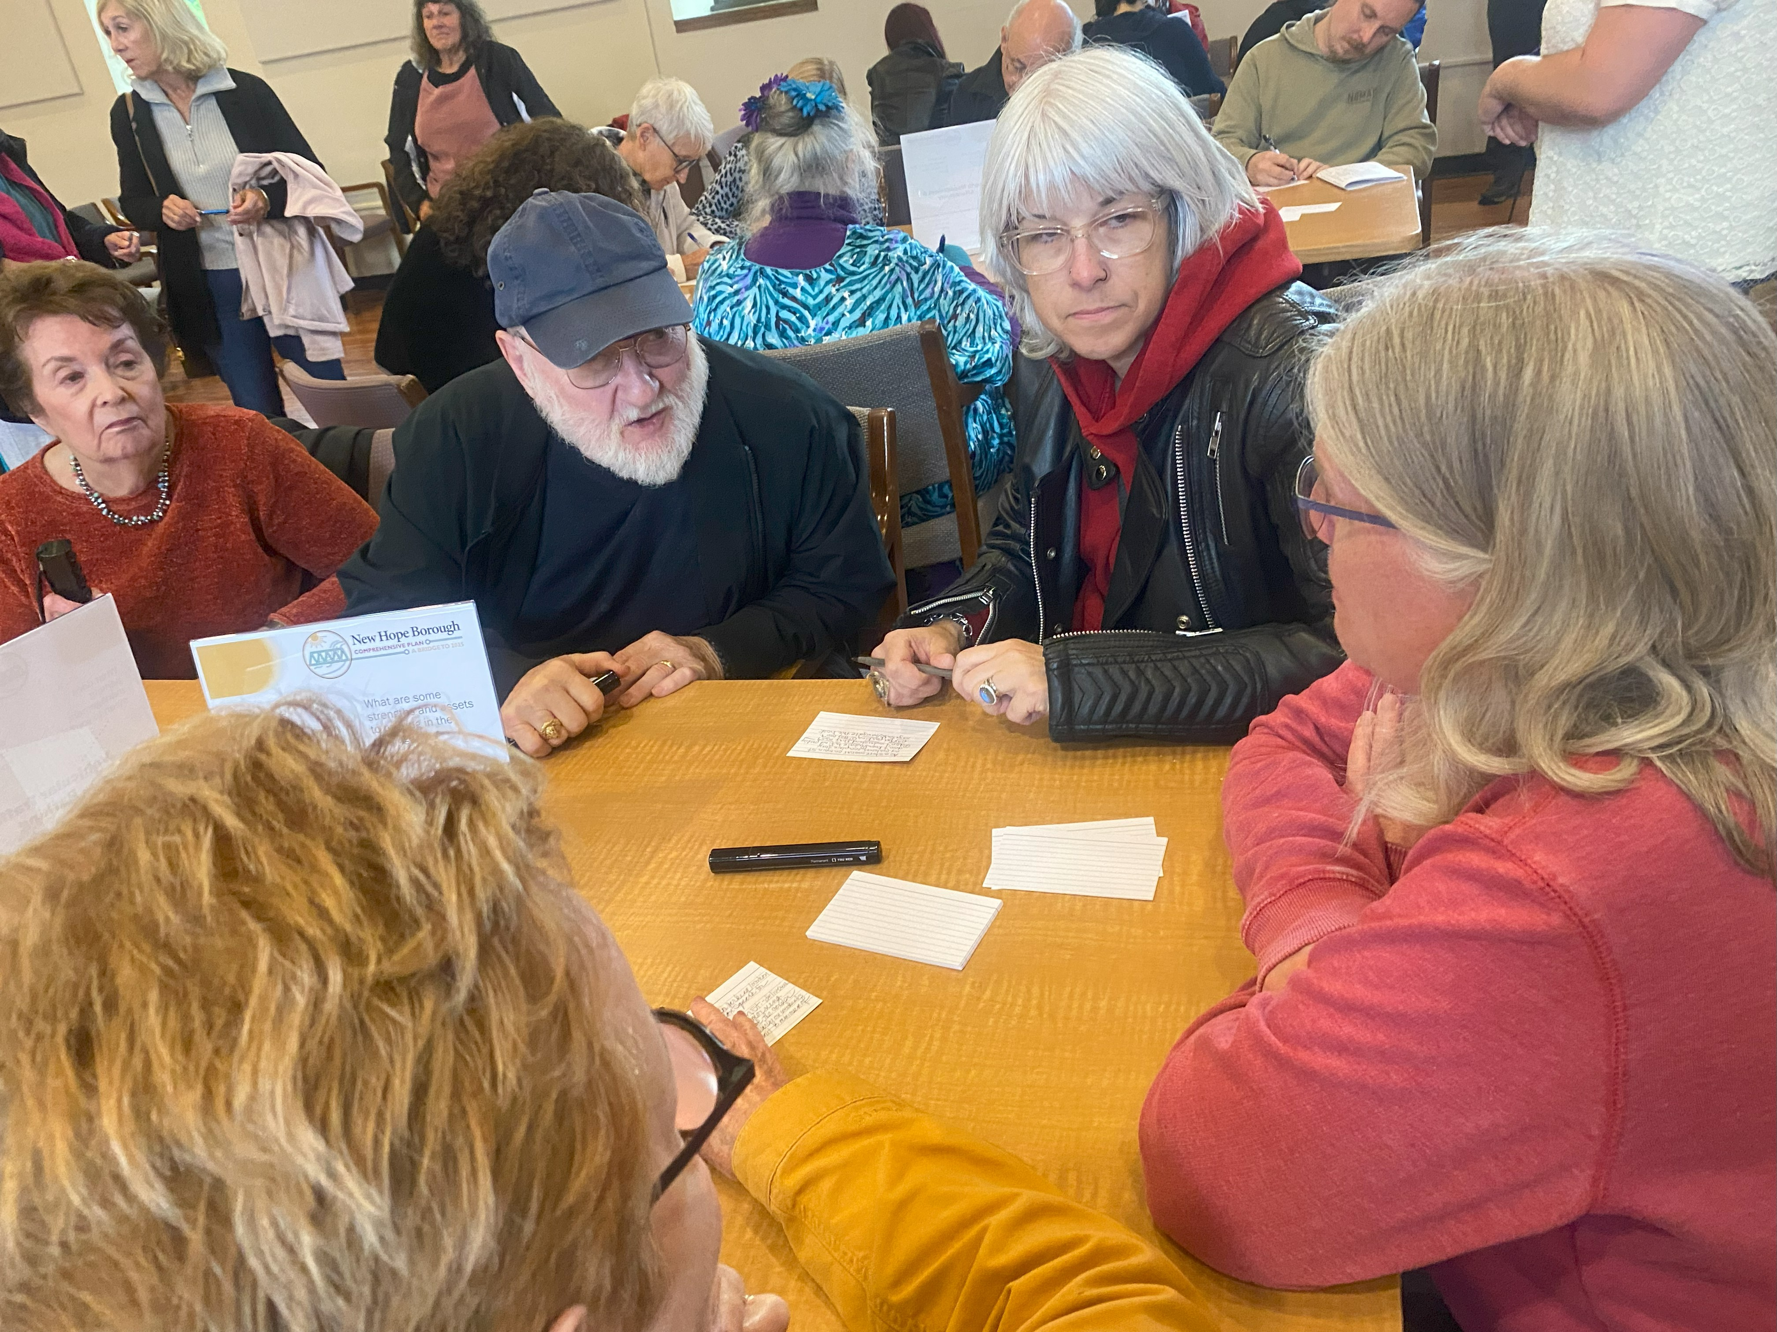
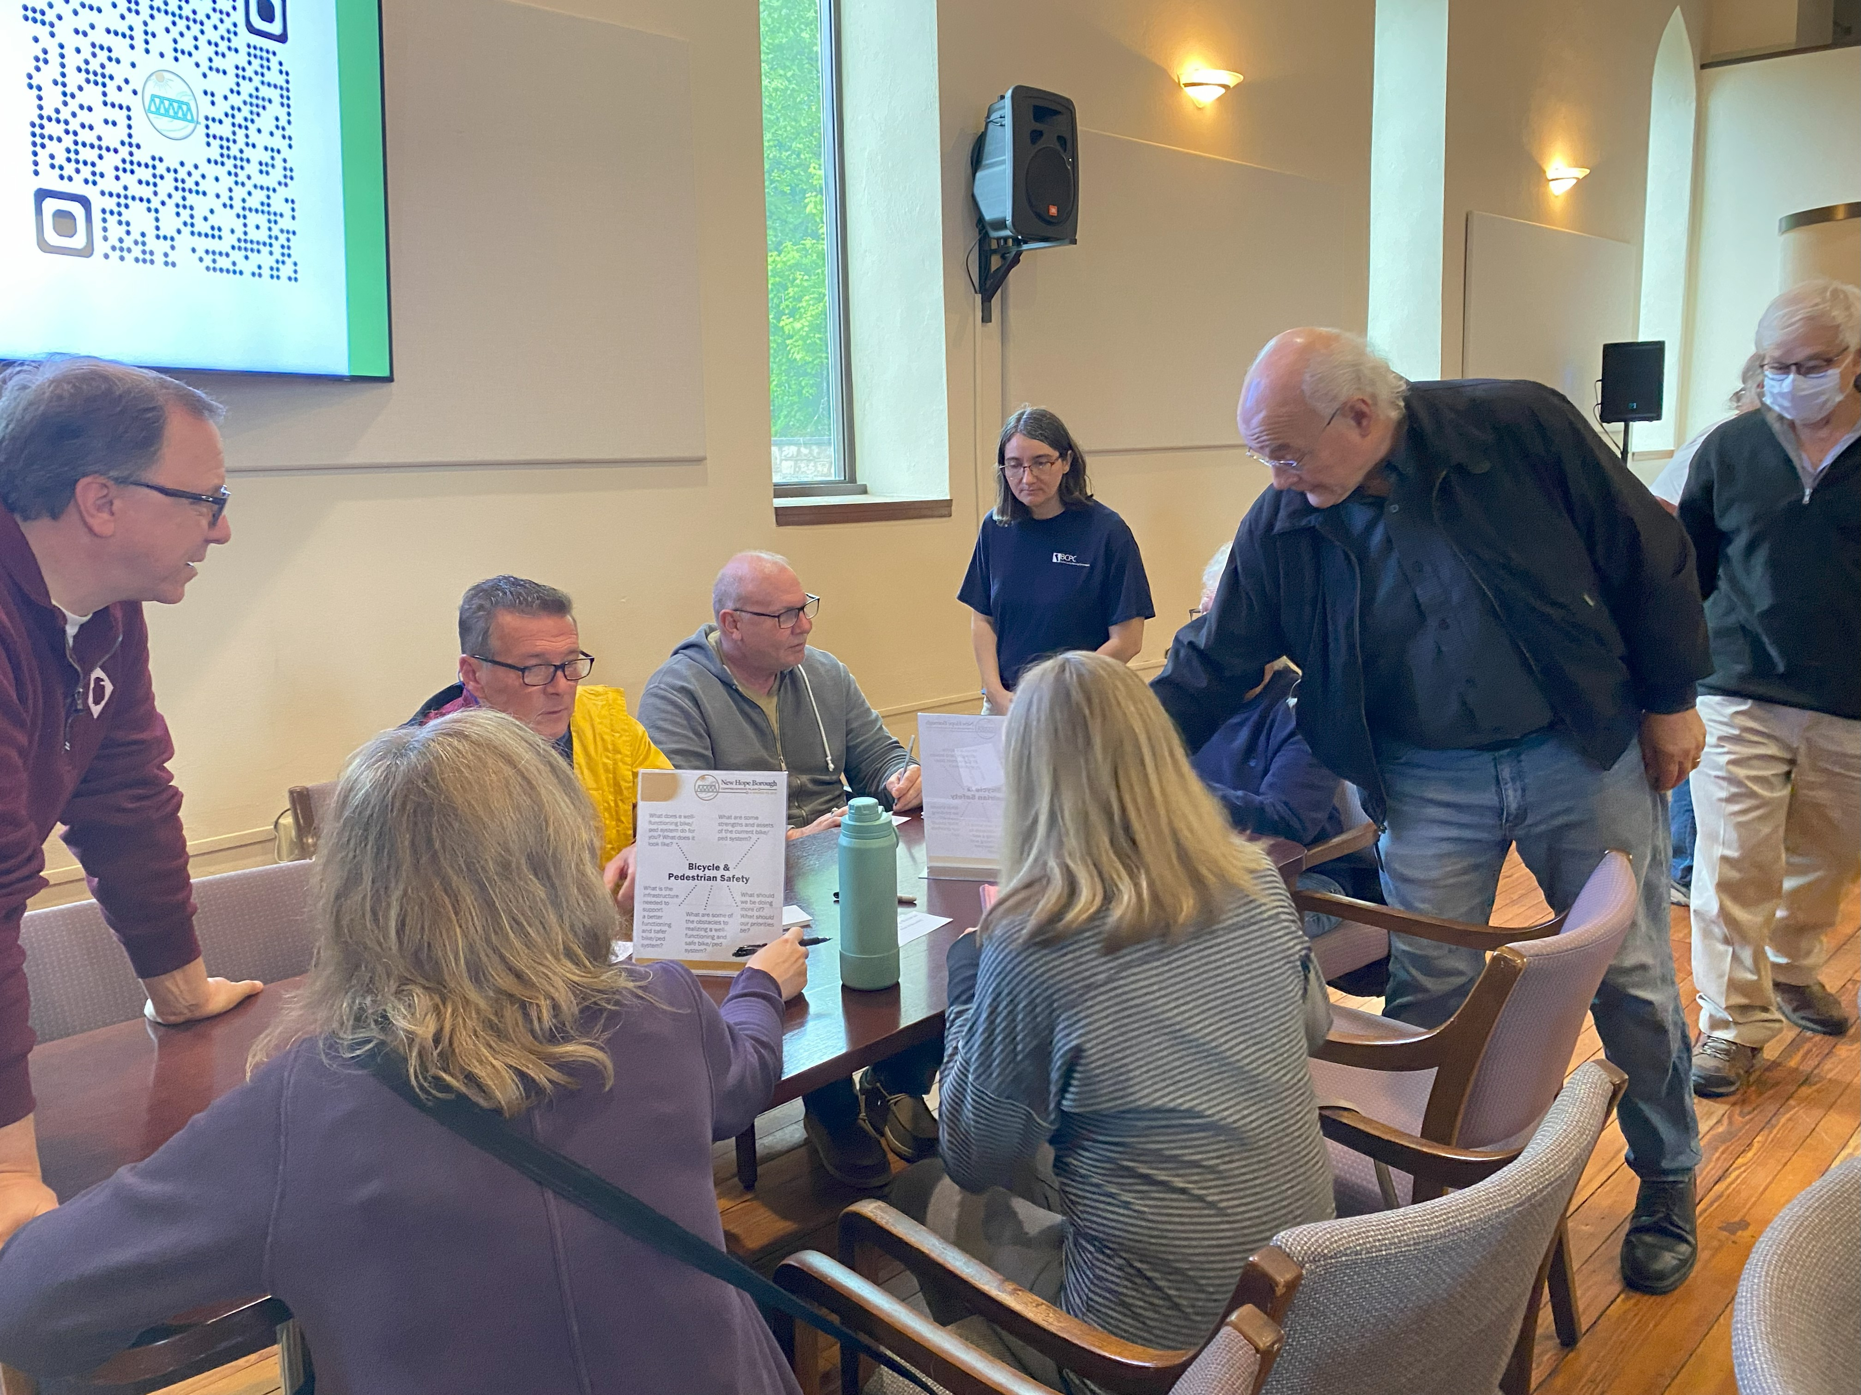
Workshop 2A (May 22, 2025)
Topics Covered
  Historic Preservation
  Vehicular Traffic & Parking
  Growth Management & Affordability
  Bicycle & Pedestrian Safety
~32 resident participants

Slide 5
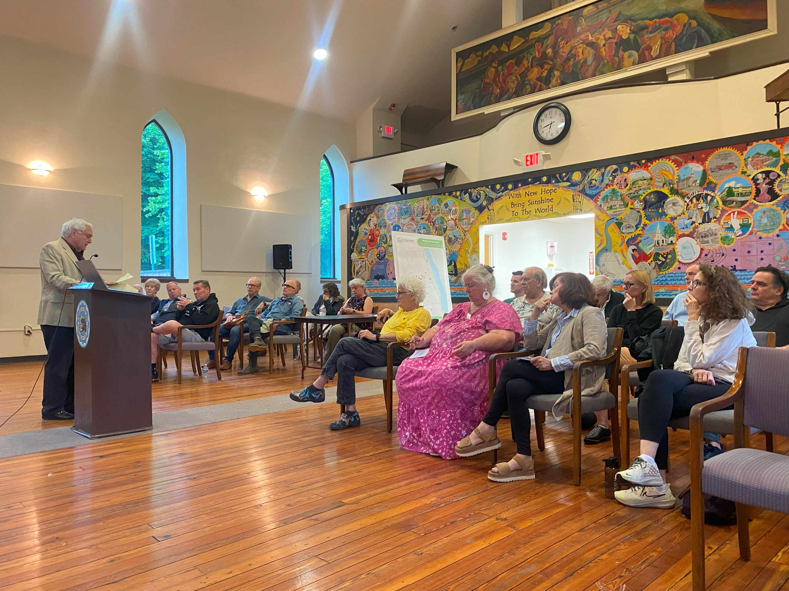
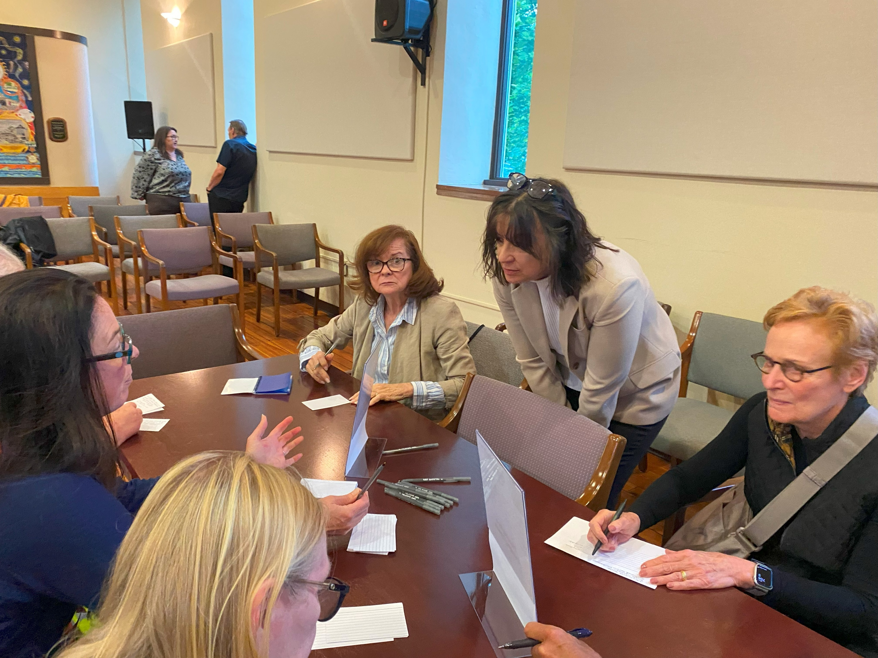
Workshop 2B (June 9, 2025)
Topics Covered
  Business Development & Tourism
  Planning for a Changing Climate
  Access to Nature & the Outdoors
~24 resident participants

Slide 6
What We’ve Learned (so far)
Key Topic Areas for the Plan
  Historic Preservation
  Vehicular Traffic & Parking
  Growth Management & Affordability
  Bicycle & Pedestrian Safety
  Business Development & Tourism
  Planning for a Changing Climate
  Access to Nature & the Outdoors

Slide 7
What We’ve Learned (so far)
Each will have…
Set of Principles (vision/ideals)
Recommended Action Items (implementation)
Key Topic Areas for the Plan
  Historic Preservation
  Vehicular Traffic & Parking
  Growth Management & Affordability
  Bicycle & Pedestrian Safety
  Business Development & Tourism
  Planning for a Changing Climate
  Access to Nature & the Outdoors

Slide 8
What We’ve Learned (so far)
Each will have…
Set of Principles (vision/ideals)
Recommended Action Items (implementation)
Key Topic Areas for the Plan
  Historic Preservation
  Vehicular Traffic & Parking
  Growth Management & Affordability
  Bicycle & Pedestrian Safety
  Business Development & Tourism
  Planning for a Changing Climate
  Access to Nature & the Outdoors
To be considered for budgetary purposes

Slide 9
Budgetary Considerations
Create a dedicated Comprehensive Plan Implementation Reserve or Fund, named broadly (e.g. Comprehensive Plan Implementation Reserve)
  Lump-sum allocation to support early implementation of the forthcoming Comprehensive Plan.
  Example uses may include ordinance updates, feasibility studies (e.g. traffic study, parking study, walkability study, hazard mitigation study), “quick-win” capital improvements, community engagement, and grant matching.
  Specific allocations to be determined by Borough Council after plan adoption.

Slide 10
Thank you – questions?

